Slide 1
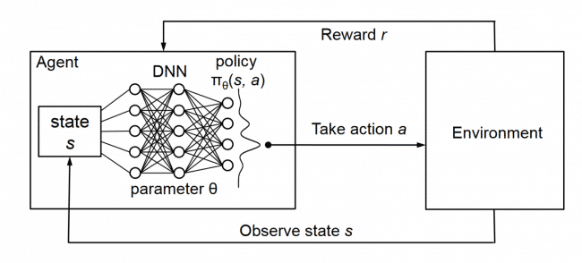
L7.3 Policy-based RL
Zonghua Gu 2021
Acknowledgement: slides based on https://www.coursera.org/specializations/reinforcement-learning
And textbook by Sutton and Barto http://incompleteideas.net/book/the-book-2nd.html

Slide 2

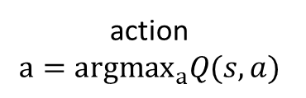




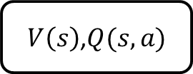




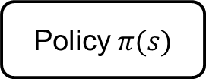
Policy-based RL
state $s$
action $a$
state $s$
action $a$
state $s$
action $a$
MDP
$V\left(s\right)$,$Q(s,a)$
Policy $π(s)$
next
state $s′$
reward $r$
action
$$a={argmax}_{a}Q(s,a)$$
action $a=π(s)$
MDP Planning | Value-based RL | Policy-based RL

Slide 3
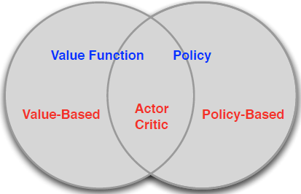
CH13 Policy Gradient Methods
Value Based
Learnt Value Function
Implicit policy (e.g. $ε$-greedy)
Policy Based
No Value Function
Learnt Policy
Actor-Critic
Learnt Value Function
Learnt Policy

Slide 4
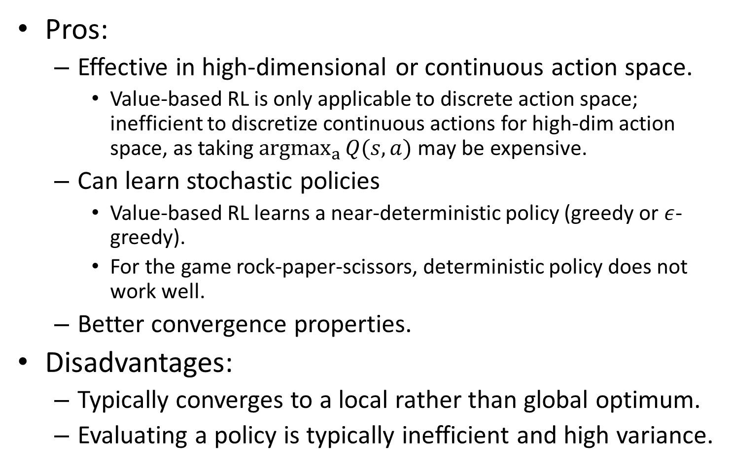
Policy-based RL Pros and Cons
Pros:
Effective in high-dimensional or continuous action space.
Value-based RL is only applicable to discrete action space; inefficient to discretize continuous actions for high-dim action space, as taking ${argmax}_{a}{Q(s,a)}$ may be expensive.
Can learn stochastic policies
Value-based RL learns a near-deterministic policy (greedy or $ε$-greedy).
For the game rock-paper-scissors, deterministic policy does not work well.
Better convergence properties.
Disadvantages:
Typically converges to a local rather than global optimum.
Evaluating a policy is typically inefficient and high variance.

Slide 5
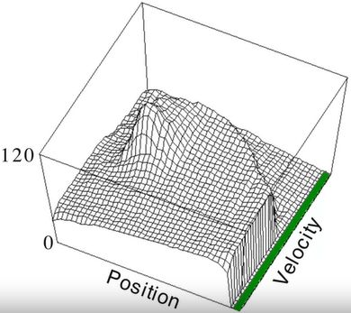
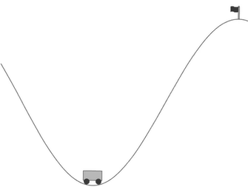
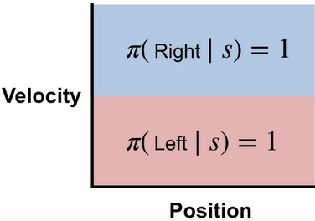
Mountain Car Example
Middle: a complex value function
Right: a simple policy that works well: accelerate in the direction of current velocity.

Slide 6
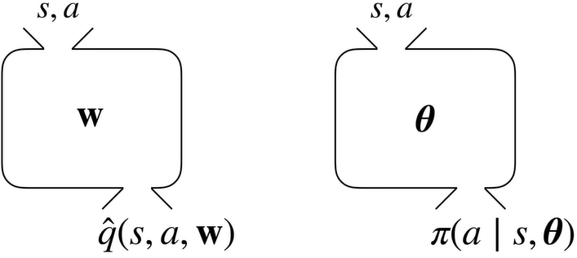
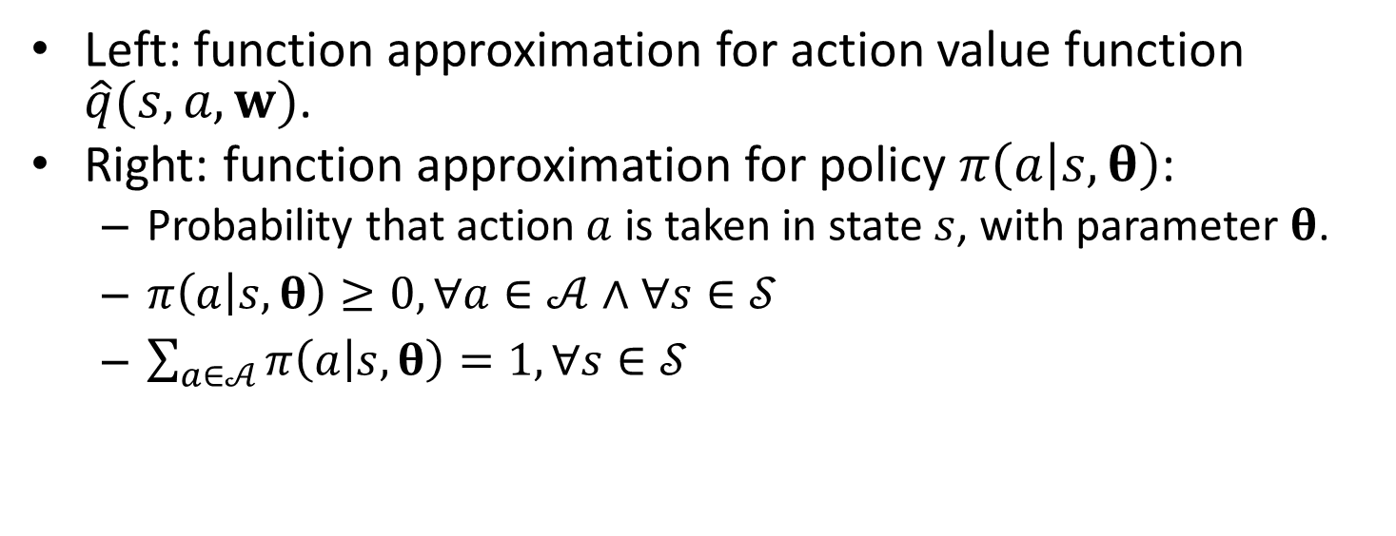
Function Approximation for Action Value Function vs. Policy
Left: function approximation for action value function $\hat{q}(s,a,w)$.
Right: function approximation for policy $π\left(a | s,θ\right)$:
Probability that action $a$ is taken in state $s$, with parameter $θ$.
$π\left(a | s,θ\right)≥0, ∀a∈𝒜∧∀s∈𝒮$
$\sum_{a∈𝒜}{π\left(a | s,θ\right)}=1,∀s∈𝒮$

Slide 7
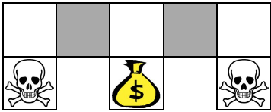
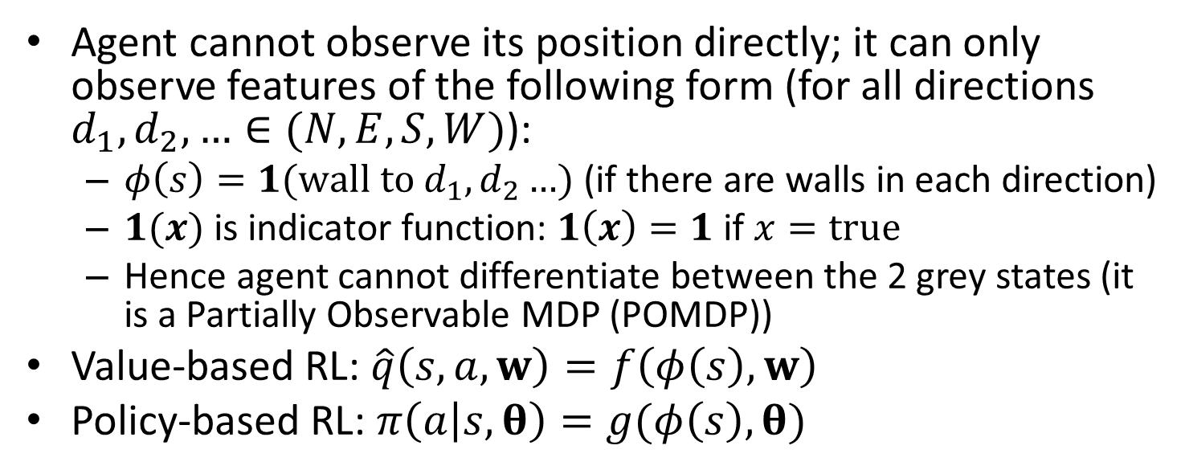
Example: Aliased Gridworld
Agent cannot observe its position directly; it can only observe features of the following form (for all directions $d_{1},d_{2},…∈(N,E,S,W)$):
$φ\left(s\right)=1(wall to d_{1},d_{2}…$) (if there are walls in each direction)
$1(x)$ is indicator function: $1\left(x\right)=1$ if $x=true$
Hence agent cannot differentiate between the 2 grey states (it is a Partially Observable MDP (POMDP))
Value-based RL: $\hat{q}\left(s,a,w\right)=f\left(φ\left(s\right),w\right)$
Policy-based RL: $π\left(a | s,θ\right)=g(φ\left(s\right),θ)$

Slide 8
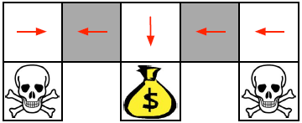
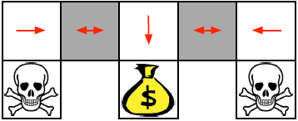
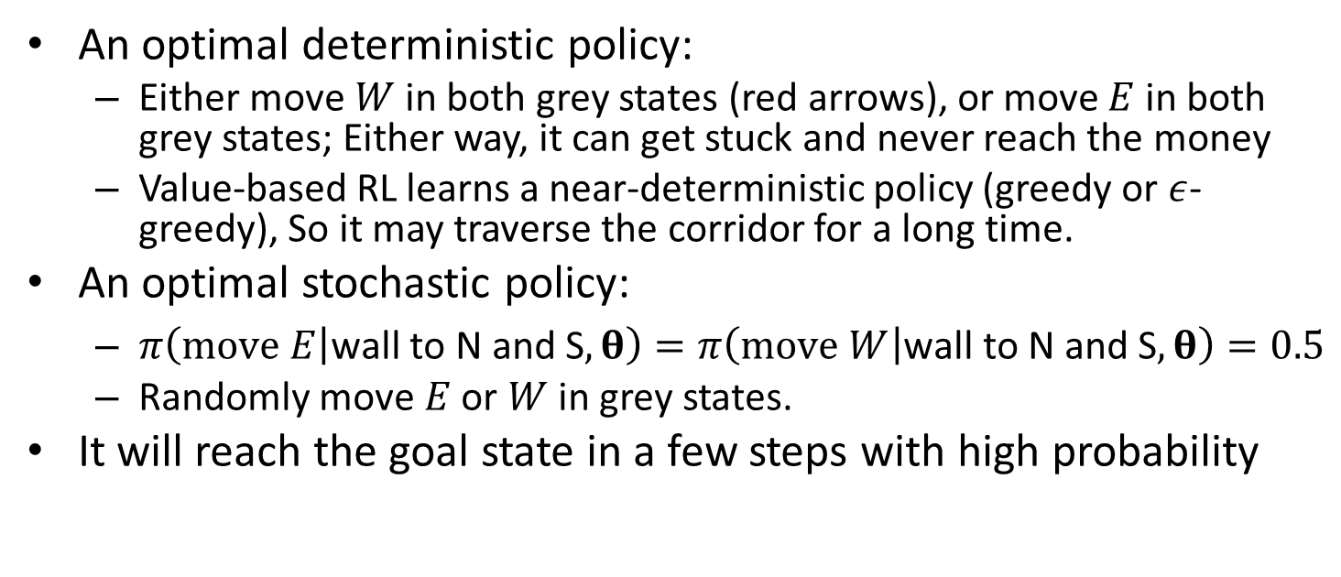
Example: Aliased Gridworld
An optimal deterministic policy:
Either move $W$ in both grey states (red arrows), or move $E$ in both grey states; Either way, it can get stuck and never reach the money
Value-based RL learns a near-deterministic policy (greedy or $ε$-greedy), So it may traverse the corridor for a long time.
An optimal stochastic policy:
$π\left(move E | \text{wall} \text{to} \text{N} \text{and} \text{S},θ\right)=π\left(move W | \text{wall} \text{to} \text{N} \text{and} \text{S},θ\right)=0.5$
Randomly move $E$ or $W$ in grey states.
It will reach the goal state in a few steps with high probability
Opt det policy
Opt Sto policy

Slide 9
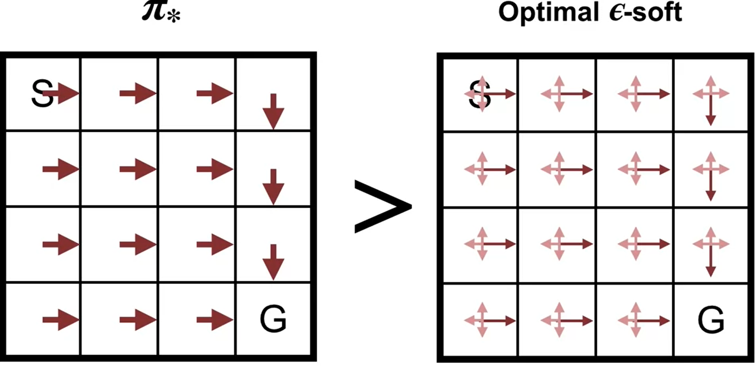

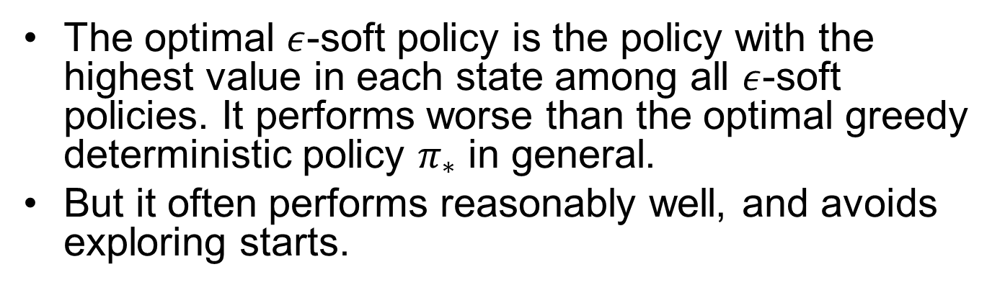
Optimal $ε$-Soft Policy
Recall
The optimal $ε$-soft policy is the policy with the highest value in each state among all $ε$-soft policies. It performs worse than the optimal greedy deterministic policy $π_{∗}$ in general.
But it often performs reasonably well, and avoids exploring starts.
Only applies to MDP, not POMDP
Notes:
If our policy always gives at least Epsilon probability to each action, it's impossible to converge to a deterministic optimal policy exploring starts can be used to find the optimal policy. But that's on

Slide 10
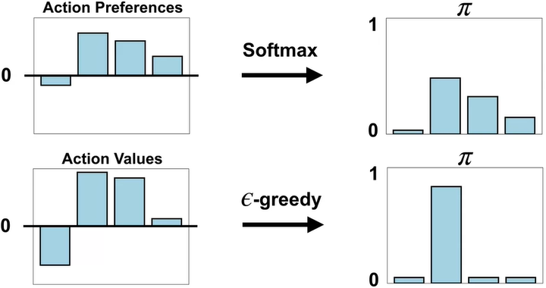
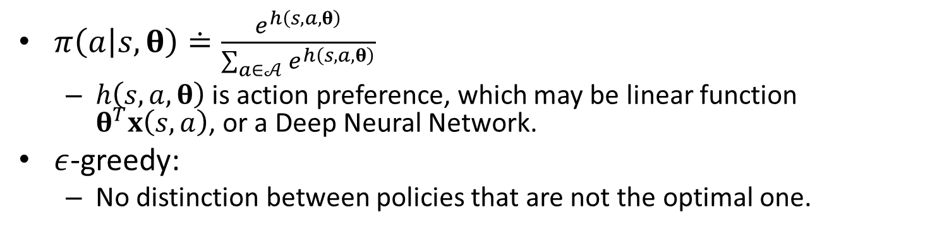
SoftMax Policy for Discrete Actions
$π\left(a | s,θ\right)≐\frac{e^{h\left(s,a,θ\right)}}{\sum_{a∈𝒜}{e^{h\left(s,a,θ\right)}}}$
$h\left(s,a,θ\right)$ is action preference, which may be linear function $θ^{T}x\left(s,a\right)$, or a Deep Neural Network.
$ε$-greedy:
No distinction between policies that are not the optimal one.
Notes:
Very bad policy is still given certain probability

Slide 11
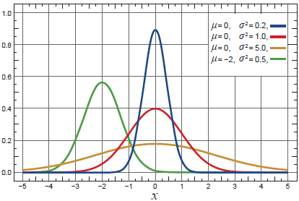
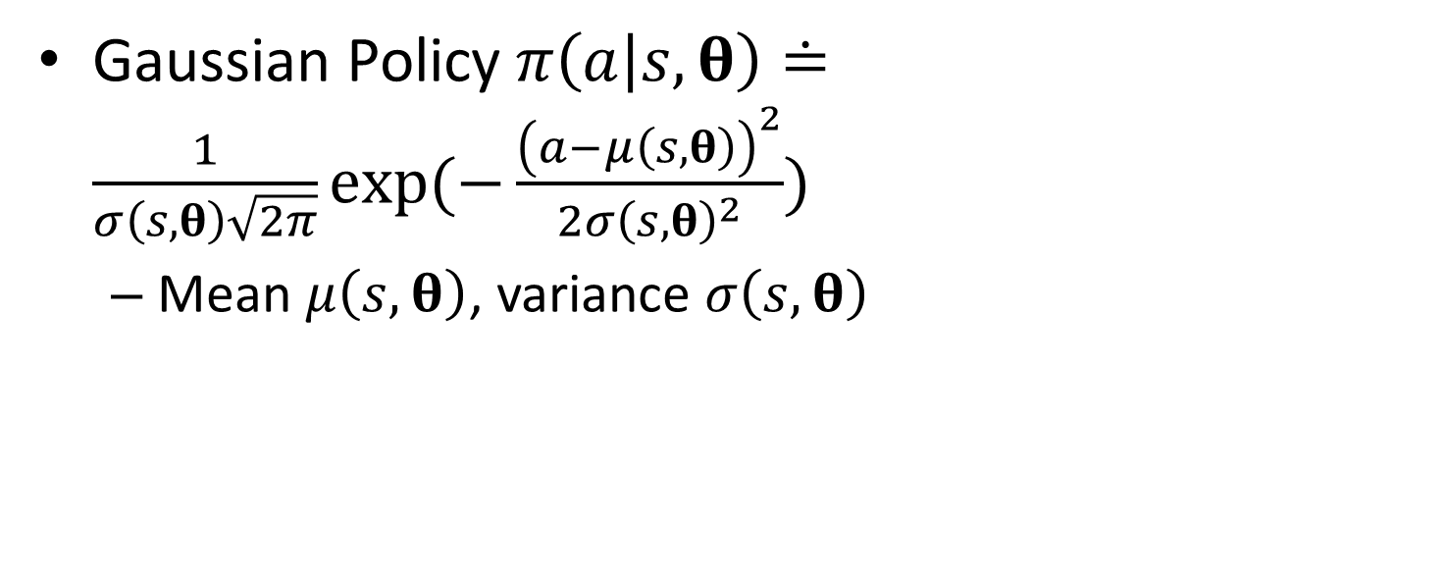
Gaussian Policy for Continuous Actions
Gaussian Policy $π\left(a | s,θ\right)≐\frac{1}{σ\left(s,θ\right)\sqrt{2π}}\exp{(−\frac{{\left(a−μ\left(s,θ\right)\right)}^{2}}{2σ{\left(s,θ\right)}^{2}}})$
Mean $μ\left(s,θ\right)$, variance $σ\left(s,θ\right)$

Slide 12
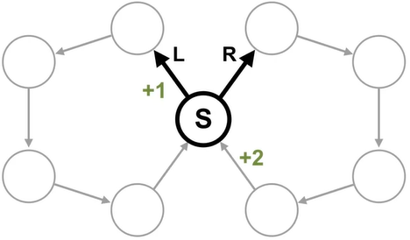
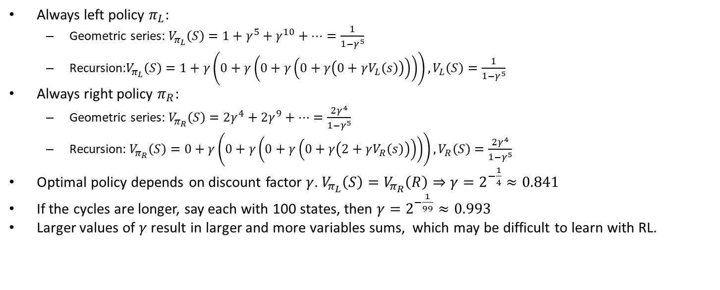
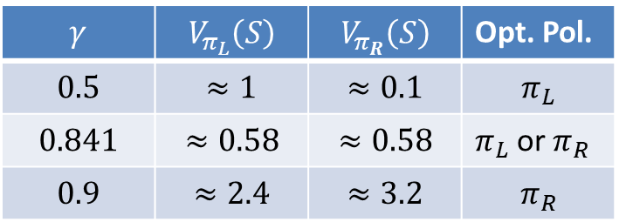
An Example MDP (Det Env)
Always left policy $π_{L}$:
Geometric series: $V_{π_{L}}\left(S\right)=1+γ^{5}+γ^{10}+…=\frac{1}{1−γ^{5}}$
Recursion:$V_{π_{L}}\left(S\right)=1+γ\left(0+γ\left(0+γ\left(0+γ\left(0+γV_{L}\left(s\right)\right)\right)\right)\right),V_{L}\left(S\right)=\frac{1}{1−γ^{5}}$
Always right policy $π_{R}$:
Geometric series: $V_{π_{R}}\left(S\right)=2γ^{4}+2γ^{9}+…=\frac{2γ^{4}}{1−γ^{5}}$
Recursion: $V_{π_{R}}\left(S\right)=0+γ\left(0+γ\left(0+γ\left(0+γ\left(2+γV_{R}\left(s\right)\right)\right)\right)\right),V_{R}\left(S\right)=\frac{2γ^{4}}{1−γ^{5}}$
Optimal policy depends on discount factor $γ$. $V_{π_{L}}\left(S\right)=V_{π_{R}}\left(R\right)⇒γ=2^{−\frac{1}{4}}≈0.841$
If the cycles are longer, say each with 100 states, then $γ=2^{−\frac{1}{99}}≈0.993$
Larger values of $γ$ result in larger and more variables sums, which may be difficult to learn with RL.
$$γ$$ | $$V_{π_{L}}\left(S\right)$$ | $$V_{π_{R}}\left(S\right)$$ | Opt. Pol.
$$0.5$$ | $$≈1$$ | $$≈0.1$$ | $$π_{L}$$
$$0.841$$ | $$≈0.58$$ | $$≈0.58$$ | $π_{L}$ or $π_{R}$
$$0.9$$ | $$≈2.4$$ | $$≈3.2$$ | $$π_{R}$$

Slide 13
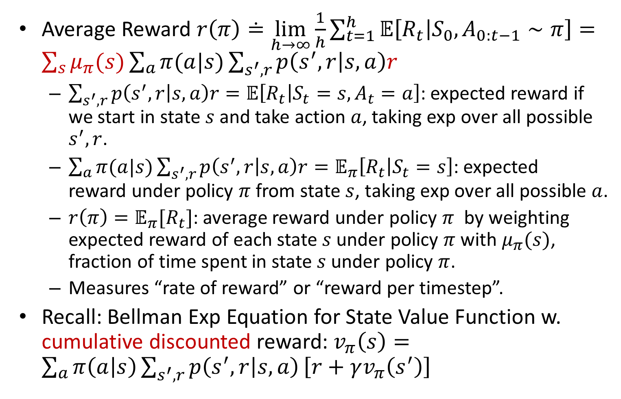
Average Reward Objective
Average Reward $r\left(π\right)≐\lim_{h→∞}\frac{1}{h}\sum_{t=1}^{h}{𝔼\left[R_{t} | S_{0},A_{0:t−1}∼π\right]}=\sum_{s}{μ_{π}(s)}\sum_{a}{π(a|s)}\sum_{s^{′},r}{p\left(s^{′},r | s,a\right)r}$
$\sum_{s^{′},r}{p\left(s^{′},r | s,a\right)r}=𝔼\left[R_{t} | S_{t}=s,A_{t}=a\right]$: expected reward if we start in state $s$ and take action $a$, taking exp over all possible $s^{′},r$.
$\sum_{a}{π(a|s)}\sum_{s^{′},r}{p\left(s^{′},r | s,a\right)r}=𝔼_{π}\left[R_{t} | S_{t}=s\right]$: expected reward under policy $π$ from state $s$, $\text{taking} \text{exp} \text{over} \text{all} \text{possible}$ $a$.
$r\left(π\right)=𝔼_{π}[R_{t}]$: average reward under policy $π$ by weighting expected reward of each state $s$ under policy $π$ with $μ_{π}(s)$, fraction of time spent in state $s$ under policy $π$.
Measures “rate of reward” or “reward per timestep”.
Recall: Bellman Exp Equation for State Value Function w. cumulative discounted reward: $v_{π}\left(s\right)=\sum_{a}{π\left(a | s\right)}\sum_{s^{′},r}{p\left(s^{′},r | s,a\right)}\left[r+γv_{π}\left(s^{′}\right)\right]$
Notes:
Let's break this formula down starting
from the inner sum and moving out.
This inner sum gives the expected reward if we
start in state S and take action A.
This is simply the sum over all rewards we might
receive weighted by their probability from S and A.
We sum over next states S prime to get
marginal probabilities over the reward.
The next level of the summation is over
all possible actions weighted
by their probability under Pi.
This gives us the expected reward
under the policy Pi from
a particular state S. Finally,
we get the overall average reward
by considering the fraction
of time we spend in state S under policy Pi.

Slide 14
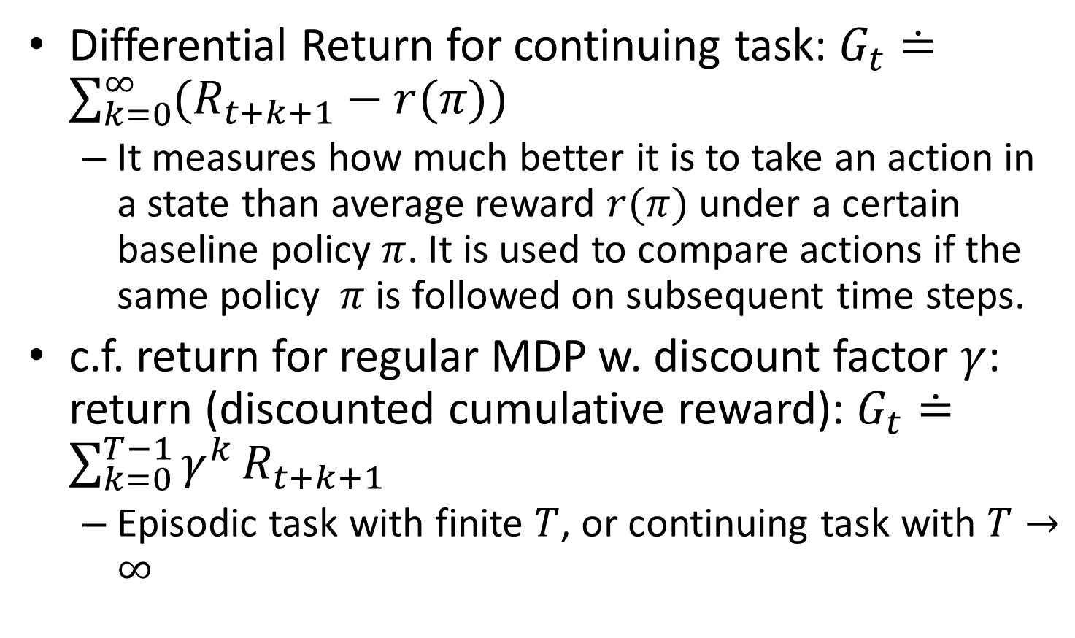
Return vs. Differential Return
Differential Return for continuing task: $G_{t}≐\sum_{k=0}^{∞}{(R_{t+k+1}}−r(π))$
It measures how much better it is to take an action in a state than average reward $r(π)$ under a certain baseline policy $π$. It is used to compare actions if the same policy $π$ is followed on subsequent time steps.
c.f. return for regular MDP w. discount factor $γ$: return (discounted cumulative reward): $G_{t}≐\sum_{k=0}^{T−1}{γ^{k}}R_{t+k+1}$
Episodic task with finite $T$, or continuing task with $T→∞$
Notes:
Episodic: $G_{t}=\sum_{t=0}^{T}{R_{t}}$

Slide 15
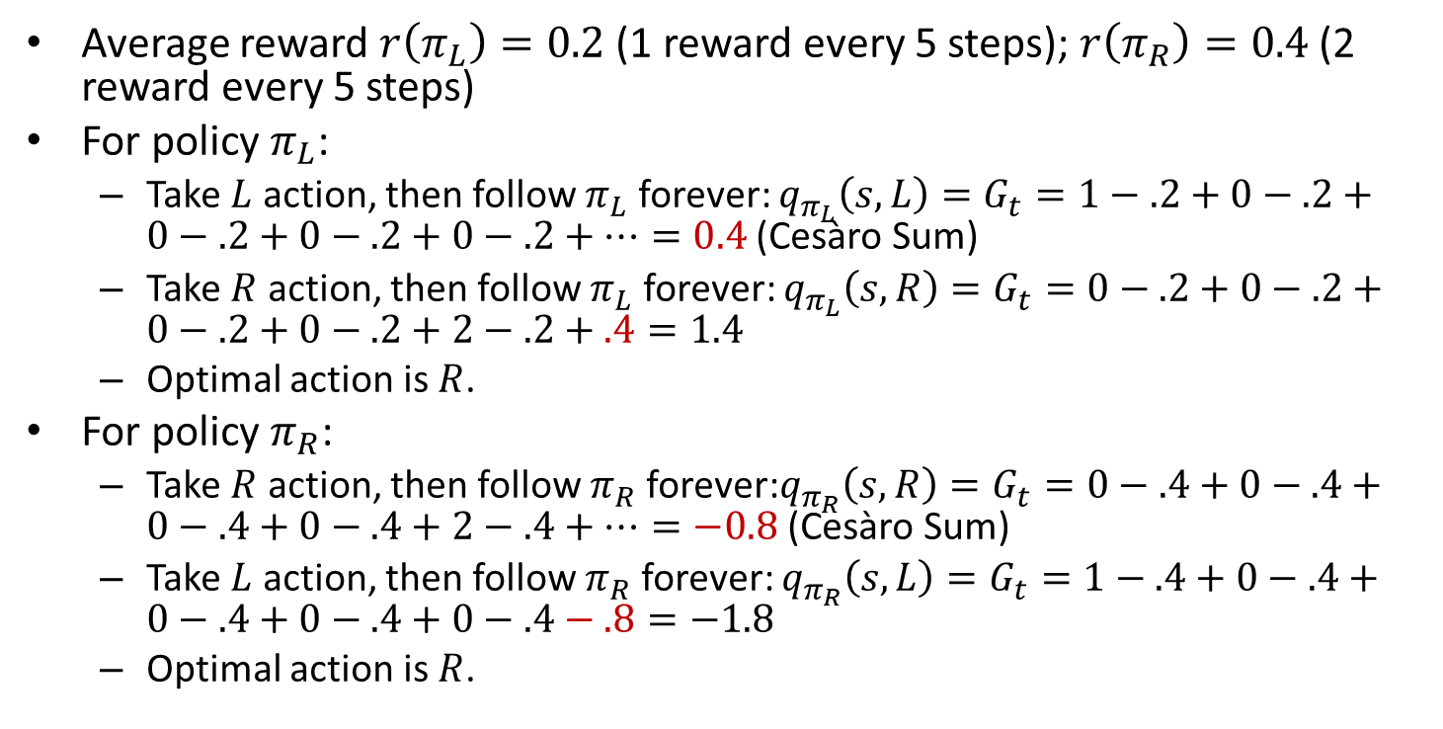
Differential Return
Average reward $r\left(π_{L}\right)=0.2$ (1 reward every 5 steps); $r\left(π_{R}\right)=0.4$ (2 reward every 5 steps)
For policy $π_{L}$:
Take $L$ action, then follow $π_{L}$ forever: $q_{π_{L}}\left(s,L\right)=G_{t}=1−.2+0−.2+0−.2+0−.2+0−.2+…=0.4$ (Cesàro Sum)
Take $R$ action, then follow $π_{L}$ forever: $q_{π_{L}}\left(s,R\right)=G_{t}=0−.2+0−.2+0−.2+0−.2+2−.2+.4=1.4$
Optimal action is $R$.
For policy $π_{R}$:
Take $R$ action, then follow $π_{R}$ forever:$q_{π_{R}}\left(s,R\right)=G_{t}=0−.4+0−.4+0−.4+0−.4+2−.4+…=−0.8$ (Cesàro Sum)
Take $L$ action, then follow $π_{R}$ forever: ${q_{π_{R}}\left(s,L\right)=G}_{t}=1−.4+0−.4+0−.4+0−.4+0−.4−.8=−1.8$
Optimal action is $R$.

Slide 16
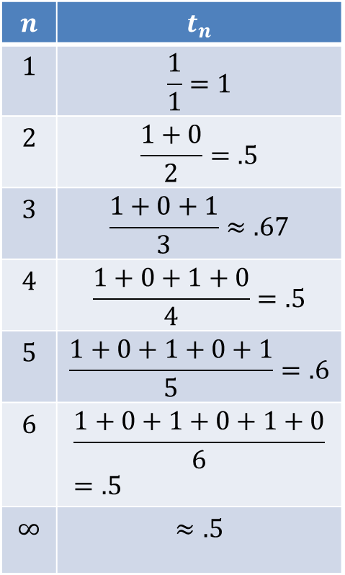
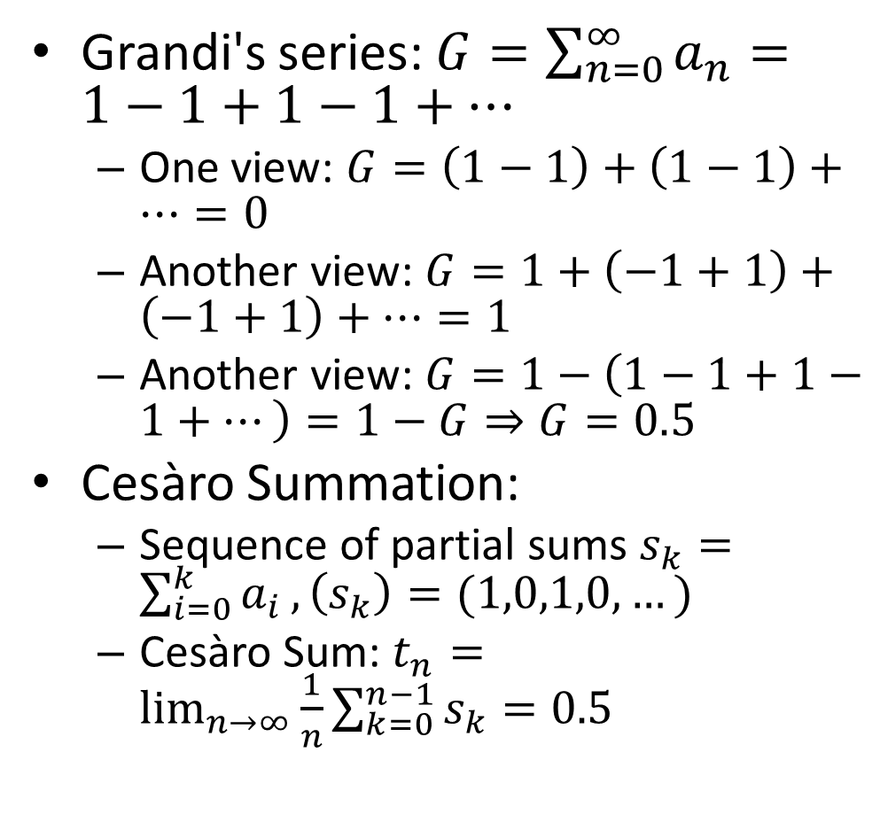
Side Note: Cesàro Summation
Grandi's series: $G=\sum_{n=0}^{∞}{a_{n}}=1−1+1−1+…$
One view: $G=\left(1−1\right)+\left(1−1\right)+…=0$
Another view: $G=1+\left(−1+1\right)+\left(−1+1\right)+…=1$
Another view: $G=1−\left(1−1+1−1+…\right)=1−G⇒G=0.5$
Cesàro Summation:
Sequence of partial sums $s_{k}=\sum_{i=0}^{k}{a_{i}},\left(s_{k}\right)=(1,0,1,0,…)$
Cesàro Sum: $t_{n}=\lim_{n→∞}{\frac{1}{n}\sum_{k=0}^{n−1}{s_{k}}}=0.5$
$$n$$ | $$t_{n}$$
$$1$$ | $$\frac{1}{1}=1$$
$$2$$ | $$\frac{1+0}{2}=.5$$
$$3$$ | $$\frac{1+0+1}{3}≈.67$$
$$4$$ | $$\frac{1+0+1+0}{4}=.5$$
$$5$$ | $$\frac{1+0+1+0+1}{5}=.6$$
$$6$$ | $$\frac{1+0+1+0+1+0}{6}=.5$$
$$∞$$ | $$≈.5$$

Slide 17
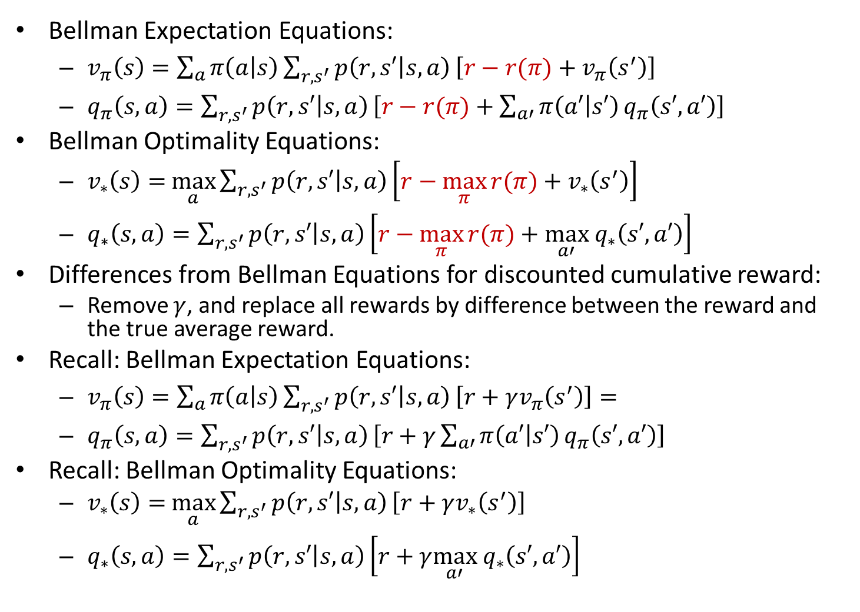
Bellman Equations for Average Reward
Bellman Expectation Equations:
$v_{π}\left(s\right)=\sum_{a}{π\left(a | s\right)}\sum_{r,s^{′}}{p\left(r,s′ | s,a\right)}\left[r−r(π)+v_{π}\left(s^{′}\right)\right]$
$q_{π}\left(s,a\right)=\sum_{r,s^{′}}{p\left(r,s′ | s,a\right)}\left[r−r(π)+\sum_{a′}{π\left(a′ | s′\right)}q_{π}\left(s′,a′\right)\right]$
Bellman Optimality Equations:
$v_{∗}\left(s\right)=$ $\max_{a}{\sum_{r,s^{′}}{p\left(r,s′ | s,a\right)}\left[r−\max_{π}{r(π)}+v_{∗}\left(s^{′}\right)\right]}$
$q_{∗}\left(s,a\right)=\sum_{r,s^{′}}{p\left(r,s′ | s,a\right)}\left[r−\max_{π}{r(π)}+\max_{a′} q_{∗}\left(s′,a′\right)\right]$
Differences from Bellman Equations for discounted cumulative reward:
Remove $γ$, and replace all rewards by difference between the reward and the true average reward.
Recall: Bellman Expectation Equations:
$v_{π}\left(s\right)=\sum_{a}{π\left(a | s\right)}\sum_{r,s^{′}}{p\left(r,s′ | s,a\right)}\left[r+γv_{π}\left(s^{′}\right)\right]=$
$q_{π}\left(s,a\right)=\sum_{r,s^{′}}{p\left(r,s′ | s,a\right)}\left[r+γ\sum_{a′}{π\left(a′ | s′\right)}q_{π}\left(s′,a′\right)\right]$
Recall: Bellman Optimality Equations:
$v_{∗}\left(s\right)=$ $\max_{a}{\sum_{r,s^{′}}{p\left(r,s′ | s,a\right)}\left[r+γv_{∗}\left(s^{′}\right)\right]}$
$q_{∗}\left(s,a\right)=\sum_{r,s^{′}}{p\left(r,s′ | s,a\right)}\left[r+γ\max_{a′} q_{∗}\left(s′,a′\right)\right]$

Slide 18
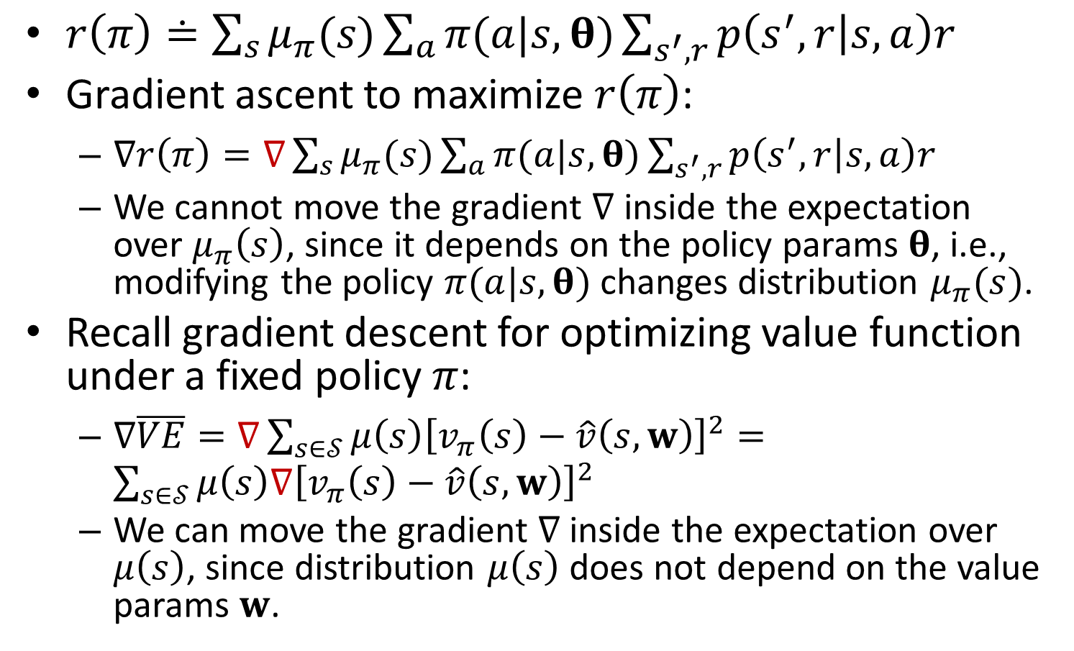
Policy Optimization w. Average Reward Objective
$r\left(π\right)≐\sum_{s}{μ_{π}(s)}\sum_{a}{π(a|s,θ)}\sum_{s^{′},r}{p\left(s^{′},r | s,a\right)r}$
Gradient ascent to maximize $r\left(π\right)$:
$∇r\left(π\right)=∇\sum_{s}{μ_{π}(s)}\sum_{a}{π(a|s,θ)}\sum_{s^{′},r}{p\left(s^{′},r | s,a\right)r}$
We cannot move the gradient $∇$ inside the expectation over $μ_{π}\left(s\right)$, since it depends on the policy params $θ$, i.e., modifying the policy $π(a|s,θ)$ changes distribution $μ_{π}(s)$.
Recall gradient descent for optimizing value function under a fixed policy $π$:
$∇\overline{VE}=∇\sum_{s∈𝒮}{μ\left(s\right){\left[v_{π}\left(s\right)−\hat{v}\left(s,w\right)\right]}^{2}}=\sum_{s∈𝒮}{μ\left(s\right)∇{\left[v_{π}\left(s\right)−\hat{v}\left(s,w\right)\right]}^{2}}$
We can move the gradient $∇$ inside the expectation over $μ\left(s\right)$, since distribution $μ\left(s\right)$ does not depend on the value params $w$.
Notes:
Let's break this formula down starting
from the inner sum and moving out.
This inner sum gives the expected reward if we
start in state S and take action A.
This is simply the sum over all rewards we might
receive weighted by their probability from S and A.
We sum over next states S prime to get
marginal probabilities over the reward.
The next level of the summation is over
all possible actions weighted
by their probability under Pi.
This gives us the expected reward
under the policy Pi from
a particular state S. Finally,
we get the overall average reward
by considering the fraction
of time we spend in state S under policy Pi.

Slide 19

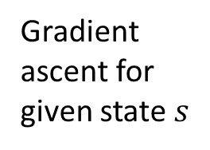
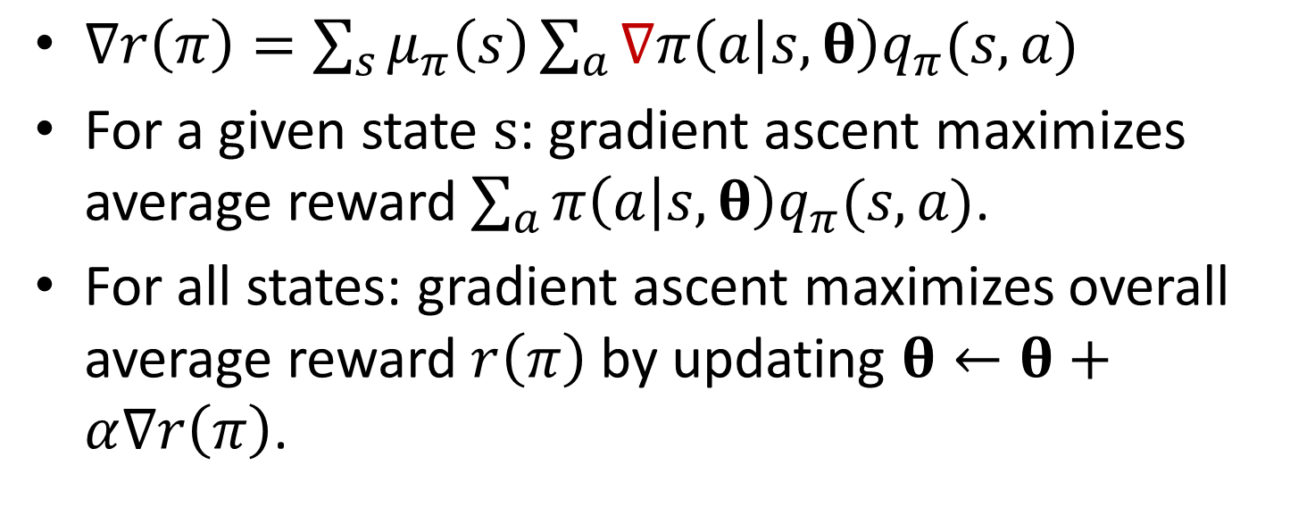
Policy Gradient Theorem
$∇r\left(π\right)=\sum_{s}{μ_{π}\left(s\right)}\sum_{a}{∇π\left(a | s,θ\right)q_{π}(s,a)}$
For a given state $s$: gradient ascent maximizes average reward $\sum_{a}{π\left(a | s,θ\right)q_{π}(s,a)}$.
For all states: gradient ascent maximizes overall average reward $r\left(π\right)$ by updating $θ←θ+α∇r\left(π\right)$.
Gradient ascent for given state $s$
Notes:
$$θ←θ+α\sum_{a}{∇π\left(a | s,θ\right)q_{π}(s,a)}$$

Slide 20
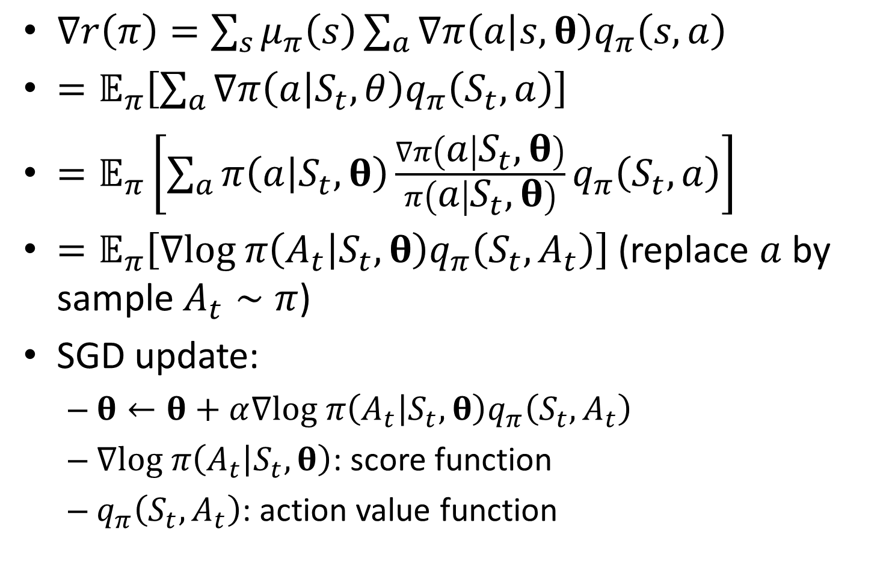
SGD for Policy Gradient
$∇r\left(π\right)=\sum_{s}{μ_{π}\left(s\right)}\sum_{a}{∇π\left(a | s,θ\right)q_{π}\left(s,a\right)}$
$=𝔼_{π}\left[\sum_{a}{∇π\left(a | S_{t},θ\right)q_{π}\left(S_{t},a\right)}\right]$
$=𝔼_{π}\left[\sum_{a}{π\left(a | S_{t},θ\right)\frac{∇π\left(a | S_{t},θ\right)}{π\left(a | S_{t},θ\right)}q_{π}\left(S_{t},a\right)}\right]$
$=𝔼_{π}\left[∇log π\left(A_{t} | S_{t},θ\right)q_{π}\left(S_{t},A_{t}\right)\right]$ (replace $a$ by sample $A_{t}∼π$)
SGD update:
$θ←θ+α∇log π\left(A_{t} | S_{t},θ\right)q_{π}\left(S_{t},A_{t}\right)$
$∇log π\left(A_{t} | S_{t},θ\right)$: score function
$q_{π}\left(S_{t},A_{t}\right)$: action value function
Notes:
$=𝔼_{π}\left[G_{t}\frac{∇π\left(A_{t} | S_{t},θ\right)}{π\left(A_{t} | S_{t},θ\right)}\right]$ (since $𝔼_{π}\left[G_{t} | S_{t},A_{t}\right]=q_{π}\left(S_{t},A_{t}\right)$)
$$=θ+αG_{t}∇\ln{π\left(A_{t} | S_{t},θ\right)}$$

Slide 21
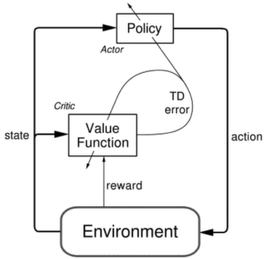
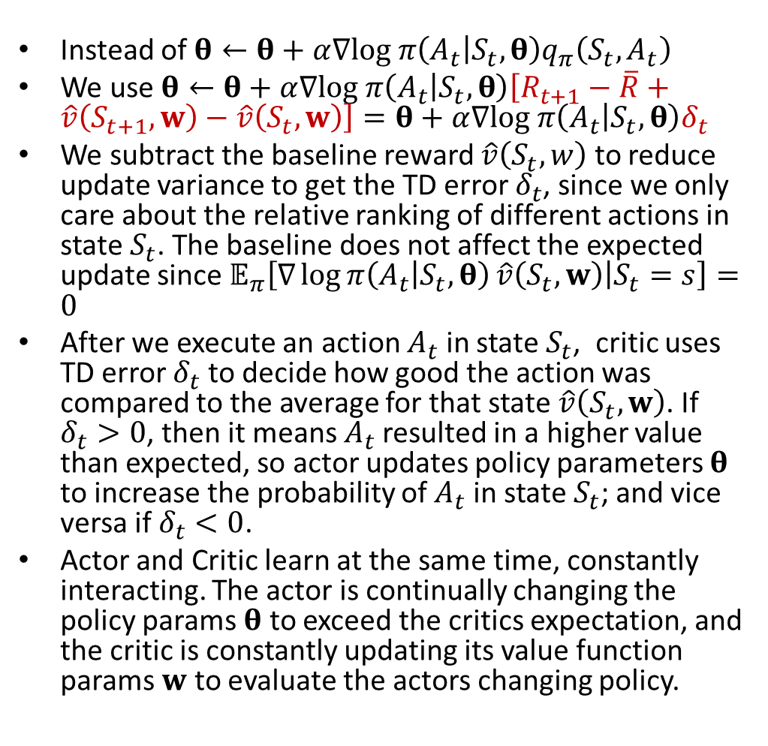
Actor-Critic Algorithm
Instead of $θ←θ+α∇log π\left(A_{t} | S_{t},θ\right)q_{π}\left(S_{t},A_{t}\right)$
We use $θ←θ+α∇log π\left(A_{t} | S_{t},θ\right)\left[R_{t+1}−\overline{R}+\hat{v}\left(S_{t+1},w\right)−\hat{v}\left(S_{t},w\right)\right]=θ+α∇log π\left(A_{t} | S_{t},θ\right)δ_{t}$
We subtract the baseline reward $\hat{v}\left(S_{t},w\right)$ to reduce update variance to get the TD error $δ_{t}$, since we only care about the relative ranking of different actions in state $S_{t}$. The baseline does not affect the expected update since $𝔼_{π}\left[∇\log{π\left(A_{t} | S_{t},θ\right)}\hat{v}\left(S_{t},w\right) | S_{t}=s\right]=0$
After we execute an action $A_{t}$ in state $S_{t}$, critic uses TD error $δ_{t}$ to decide how good the action was compared to the average for that state $\hat{v}\left(S_{t},w\right)$. If $δ_{t}>0$, then it means $A_{t}$resulted in a higher value than expected, so actor updates policy parameters $θ$ to increase the probability of $A_{t}$ in state $S_{t}$; and vice versa if $δ_{t}<0$.
Actor and Critic learn at the same time, constantly interacting. The actor is continually changing the policy params $θ$ to exceed the critics expectation, and the critic is constantly updating its value function params $w$ to evaluate the actors changing policy.
Notes:
After we execute an action,
we use the TD error to decide how good the action
was compared to the average for that state.
If the TD error is positive,
then it means the selected action
resulted in a higher value than expected.
Taking that action more often should improve our policy.
That is exactly what this update does.
It changes the policy parameters
to increase the probability of
actions that were better than
expected according to the critic.
Correspondingly, if the critic is
disappointed and the TD error is negative,
then the probability of the action is decreased.
The actor and the critic learn at
the same time, constantly interacting.
The actor is continually changing
the policy to exceed the critics expectation,
and the critic is constantly updating
its value function to
evaluate the actors changing policy.
Actor estimates $q_{π}\left(S_{t},A_{t}\right)𝔼_{π}[∇\ln{π\left(A_{t} | S_{t},θ\right)}\left[R_{t+1}−\overline{R}+\hat{v}\left(S_{t+1},w\right)−\hat{v}\left(S_{t},w\right)] | S_{t}=s\right]$
$$=𝔼_{π}[∇\ln{π\left(A_{t} | S_{t},θ\right)}\left[R_{t+1}−\overline{R}+\hat{v}\left(S_{t+1},w\right)] | S_{t}=s\right]$$

Slide 22
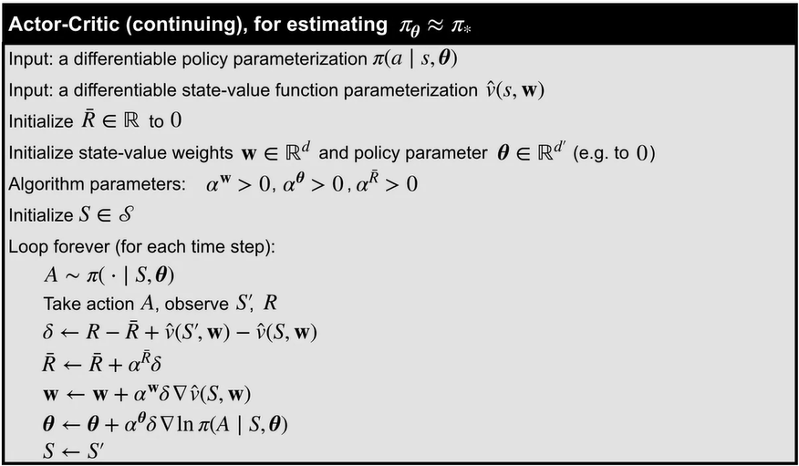
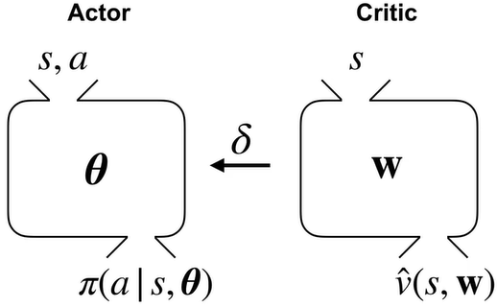
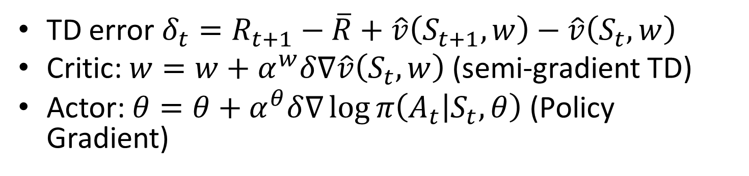
Actor-Critic Algorithm
TD error $δ_{t}=R_{t+1}−\overline{R}+\hat{v}\left(S_{t+1},w\right)−\hat{v}\left(S_{t},w\right)$
Critic: $w=w+α^{w}δ∇\hat{v}\left(S_{t},w\right)$ (semi-gradient TD)
Actor: $θ=θ+α^{θ}δ∇\log{π\left(A_{t} | S_{t},θ\right)}$ (Policy Gradient)
Notes:
tries to maximize value function

Slide 23
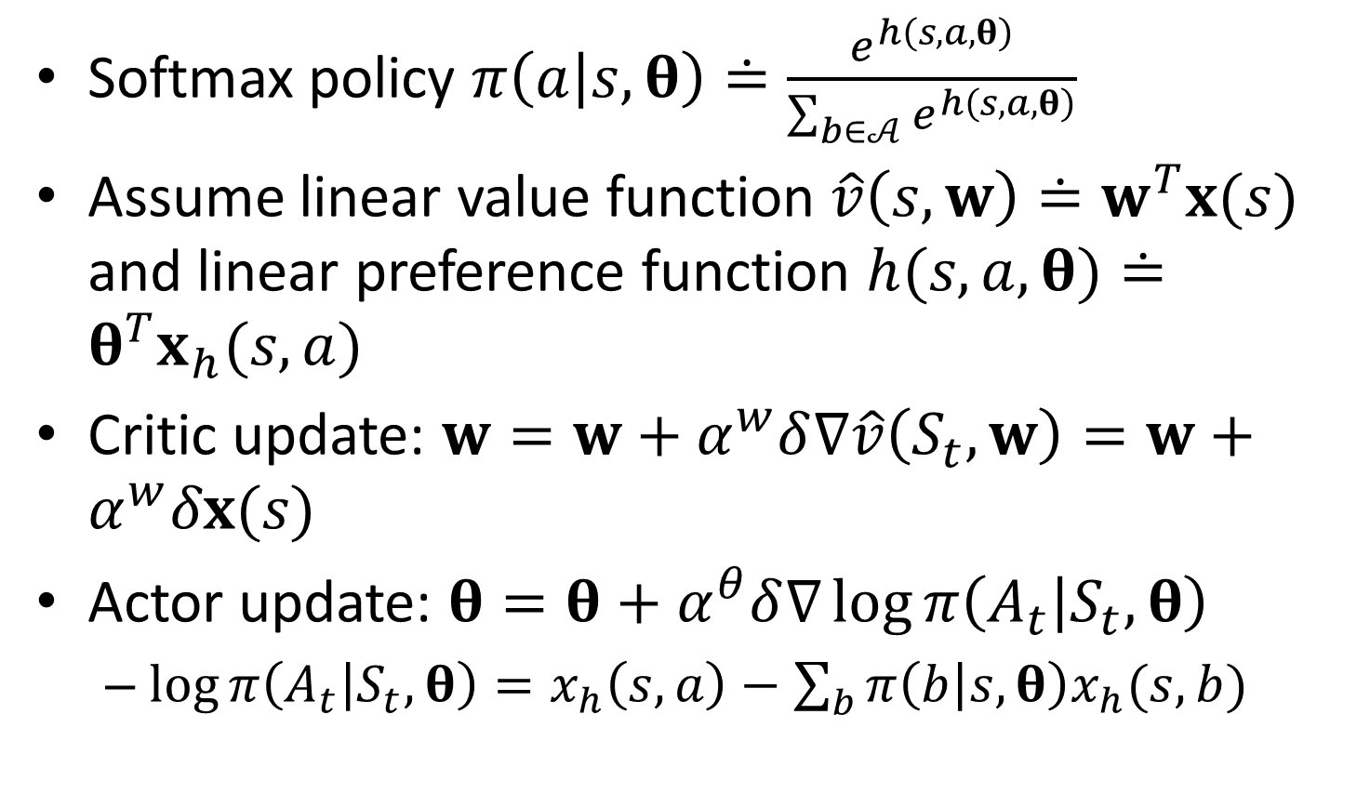
Actor-Critic with Softmax Policies
Softmax policy $π\left(a | s,θ\right)≐\frac{e^{h\left(s,a,θ\right)}}{\sum_{b∈𝒜}{e^{h\left(s,a,θ\right)}}}$
Assume linear value function $\hat{v}\left(s,w\right)≐w^{T}x(s)$ and linear preference function $h(s,a,θ)≐θ^{T}x_{h}(s,a)$
Critic update: $w=w+α^{w}δ∇\hat{v}\left(S_{t},w\right)=w+α^{w}δx(s)$
Actor update: $θ=θ+α^{θ}δ∇\log{π\left(A_{t} | S_{t},θ\right)}$
$\log{π\left(A_{t} | S_{t},θ\right)}=x_{h}\left(s,a\right)−\sum_{b}{π\left(b | s,θ\right)x_{h}(s,b)}$

Slide 24
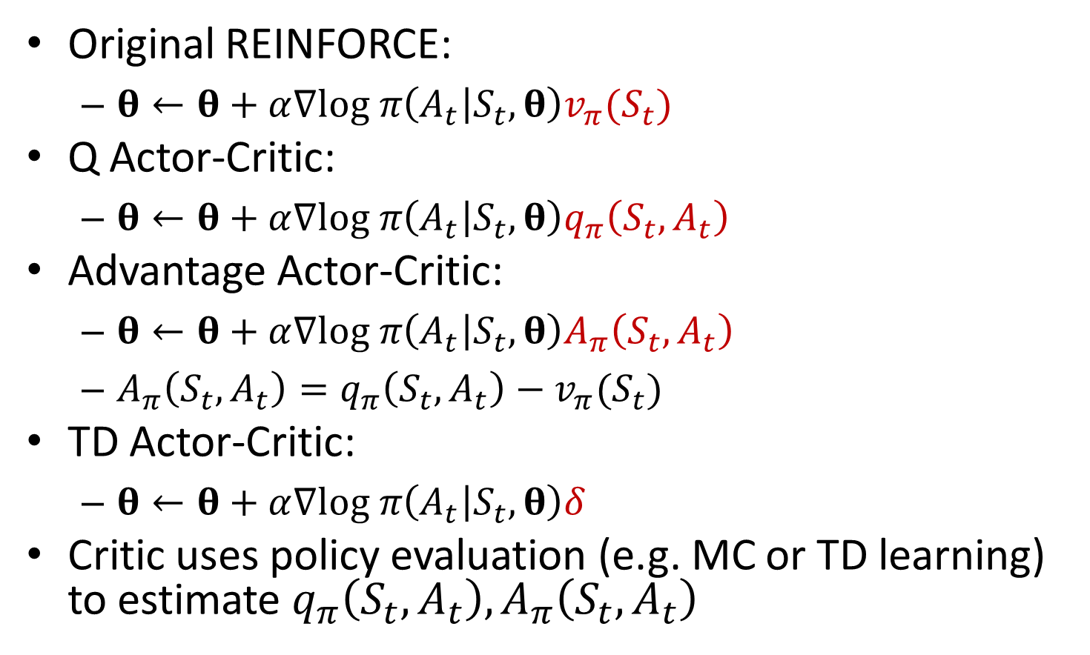
Many Variants of PG
Original REINFORCE:
$θ←θ+α∇log π\left(A_{t} | S_{t},θ\right)v_{π}(S_{t})$
Q Actor-Critic:
$θ←θ+α∇log π\left(A_{t} | S_{t},θ\right)q_{π}\left(S_{t},A_{t}\right)$
Advantage Actor-Critic:
$θ←θ+α∇log π\left(A_{t} | S_{t},θ\right)A_{π}\left(S_{t},A_{t}\right)$
$A_{π}\left(S_{t},A_{t}\right)=q_{π}\left(S_{t},A_{t}\right)−v_{π}(S_{t})$
TD Actor-Critic:
$θ←θ+α∇log π\left(A_{t} | S_{t},θ\right)δ$
Critic uses policy evaluation (e.g. MC or TD learning) to estimate $q_{π}\left(S_{t},A_{t}\right),A_{π}\left(S_{t},A_{t}\right)$
Notes:
Original REINFORCE:
Is it correct

Slide 25
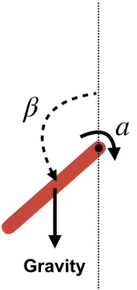
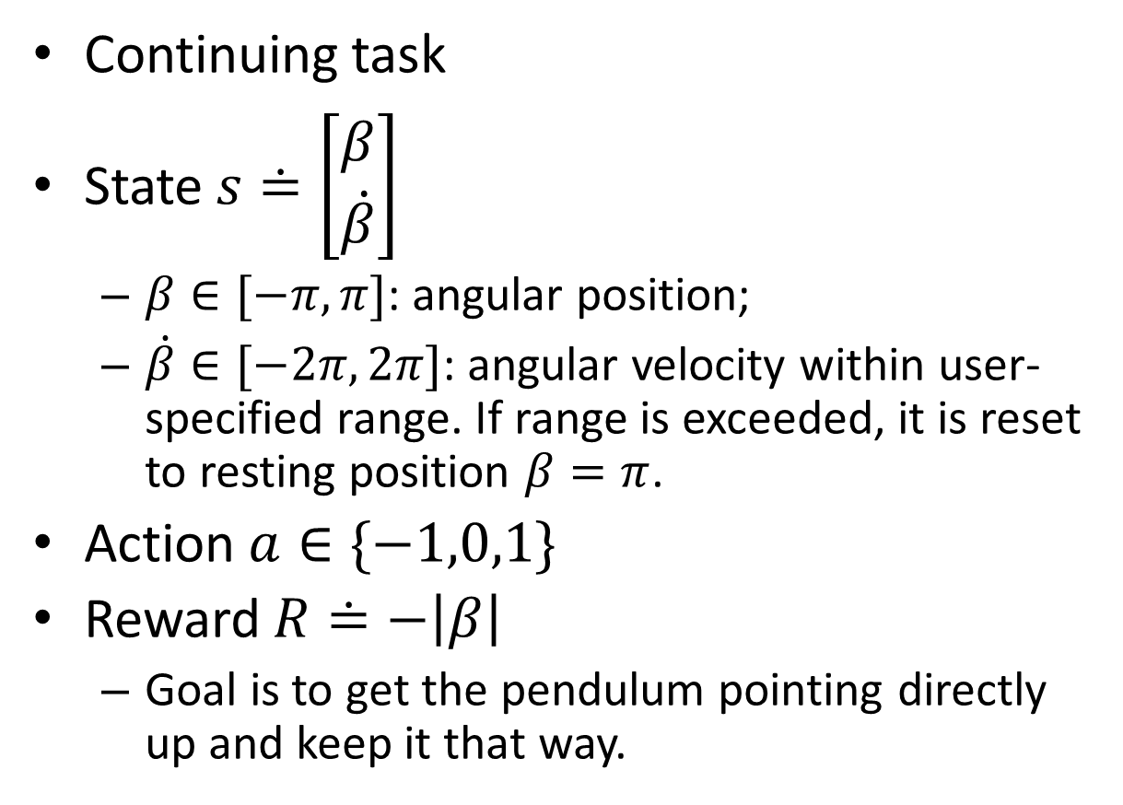
Pendulum Swingup
Continuing task
State $s≐\left[\begin{matrix}β \\ \dot{β}\end{matrix}\right]$
$β∈[−π,π]$: angular position;
$\dot{β}∈[−2π,2π]$: angular velocity within user-specified range. If range is exceeded, it is reset to resting position $β=π$.
Action $a∈\{−1,0,1\}$
Reward $R≐−\left|β\right|$
Goal is to get the pendulum pointing directly up and keep it that way.

Slide 26
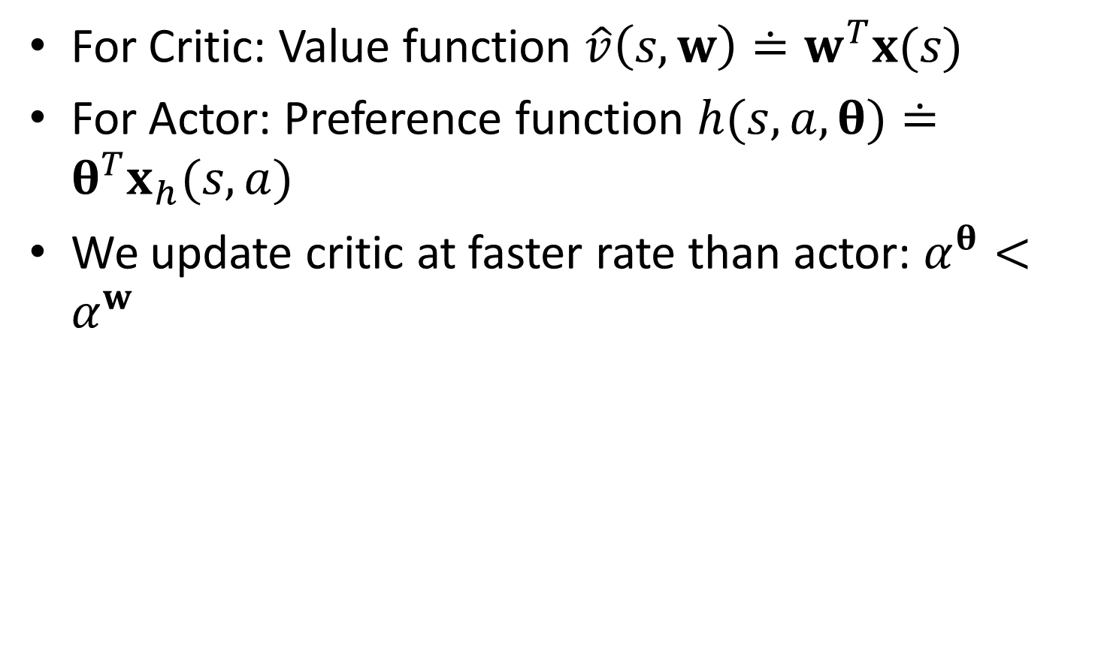
For Critic: Value function $\hat{v}\left(s,w\right)≐w^{T}x(s)$
For Actor: Preference function $h(s,a,θ)≐θ^{T}x_{h}(s,a)$
We update critic at faster rate than actor: $α^{θ}<α^{w}$

Slide 27
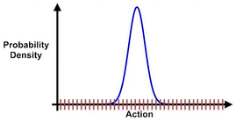
Advantages of Continuous Actions
It might not be straightforward to choose a proper discrete set of actions
Continuous actions allow us to generalize over actions
If an action is good, its neighboring actions are also likely to be good
Discrete actions lack generalization: each action is independent of others, including its neighbors (similar to value functions for discrete states)
Notes:
Natural extension of discrete actions with fine discretization

Slide 28
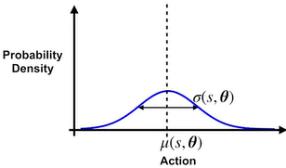
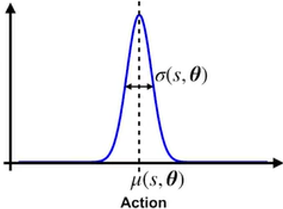
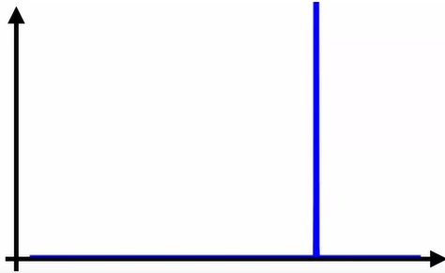
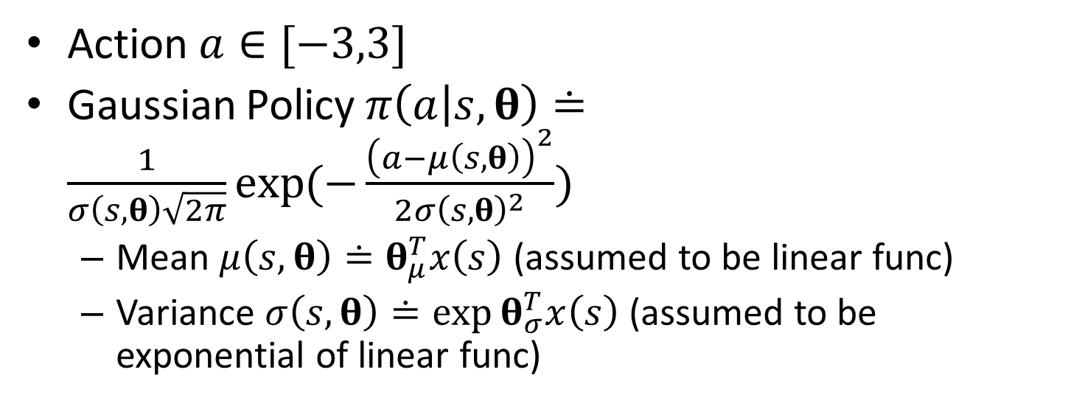


Gaussian Policies for Continuous Actions
Action $a∈[−3,3]$
Gaussian Policy $π\left(a | s,θ\right)≐\frac{1}{σ\left(s,θ\right)\sqrt{2π}}\exp{(−\frac{{\left(a−μ\left(s,θ\right)\right)}^{2}}{2σ{\left(s,θ\right)}^{2}}})$
Mean $μ\left(s,θ\right)≐θ_{μ}^{T}x\left(s\right)$ (assumed to be linear func)
Variance $σ\left(s,θ\right)≐\exp{θ_{σ}^{T}x\left(s\right)}$ (assumed to be exponential of linear func)
AC learning
AC learning
Policy variance $σ\left(s,θ\right)$ initially large
$σ\left(s,θ\right)$gradually reduced during learning w. PG,
converging towards deterministic policy

Slide 29

Taking Gradients of Log Policy
$π\left(a | s,θ\right)≐\frac{1}{σ\left(s,θ\right)\sqrt{2π}}\exp{(−\frac{{\left(a−μ\left(s,θ_{μ}\right)\right)}^{2}}{2σ{\left(s,θ_{σ}\right)}^{2}}})$
$∇log{π\left(a | s,θ_{μ}\right)=}\frac{1}{σ{\left(s,θ\right)}^{2}}\left(a−μ\left(s,θ\right)\right)x(s)$
Proof: $∇log{π\left(a | s,θ_{μ}\right)}=\frac{∇π\left(a | s,θ_{μ}\right)}{π\left(a | s,θ_{μ}\right)}=\frac{\frac{1}{σ\left(s,θ\right)\sqrt{2π}}∇exp{(−\frac{{\left(a−θ_{μ}^{T}x\left(s\right)\right)}^{2}}{2σ{\left(s,θ\right)}^{2}}})}{\frac{1}{σ\left(s,θ\right)\sqrt{2π}}\exp{(−\frac{{\left(a−θ_{μ}^{T}x\left(s\right)\right)}^{2}}{2σ{\left(s,θ\right)}^{2}}})}=\frac{1}{σ{\left(s,θ\right)}^{2}}\left(a−μ\left(s,θ\right)\right)x(s)$
$∇log{π\left(a | s,θ_{σ}\right)}=(\frac{{\left(a−μ\left(s,θ\right)\right)}^{2}}{σ{\left(s,θ\right)}^{2}}−1)x(s)$
Proof: $∇log{π\left(a | s,θ_{σ}\right)}=\frac{∇π\left(a | s,θ_{σ}\right)}{π\left(a | s,θ_{σ}\right)}=\frac{∇\frac{1}{\exp{θ_{σ}^{T}x\left(s\right)}\sqrt{2π}}exp{(−\frac{{\left(a−μ\left(s,θ\right)\right)}^{2}}{2\exp{2θ_{σ}^{T}x\left(s\right)}}})}{\frac{1}{\exp{θ_{σ}^{T}x\left(s\right)}\sqrt{2π}}\exp{(−\frac{{\left(a−μ\left(s,θ\right)\right)}^{2}}{2\exp{2θ_{σ}^{T}x\left(s\right)}}})}=\frac{(−x\left(s\right)\exp{−θ_{σ}^{T}x\left(s\right)}+\exp{−θ_{σ}^{T}x\left(s\right)}x\left(s\right){\left(a−μ\left(s,θ\right)\right)}^{2}exp{−2θ_{σ}^{T}x\left(s\right)})exp{(−\frac{{\left(a−μ\left(s,θ\right)\right)}^{2}}{2\exp{2θ_{σ}^{T}x\left(s\right)}}})}{\exp{−θ_{σ}^{T}x\left(s\right)}\exp{(−\frac{{\left(a−μ\left(s,θ\right)\right)}^{2}}{2\exp{2θ_{σ}^{T}x\left(s\right)}}})}=(\frac{{\left(a−μ\left(s,θ\right)\right)}^{2}}{σ{\left(s,θ\right)}^{2}}−1)x(s)$

Slide 30


